Slide 1

Predicting customer buying behaviour

Slide 2
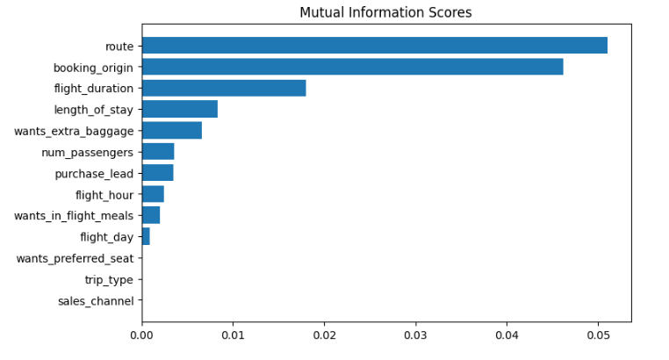
predictive model to understand factors that influence buying behaviour
We have trained the data set with XGBoost Classifier, Decision Tree Regressor, Random Forest Classifier.
Top 5 features which influence Customer buying behavior are:
Route
booking_origin
flight_duration
wants_extra_baggage
length_of_stay
We need to increase the AUC score.

Slide 3
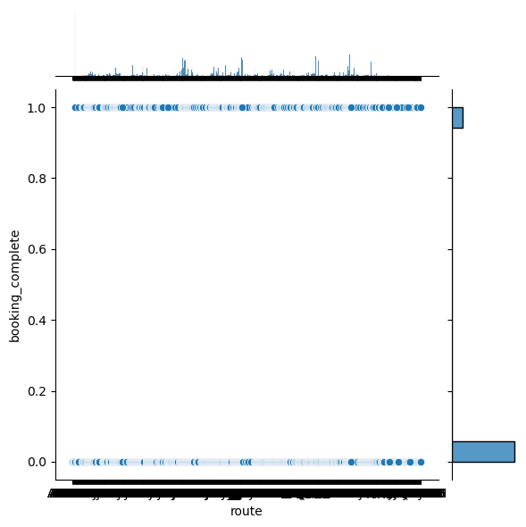
Model Evaluation
Random Forest Classifier:
Accuracy: 84.%
AUC Score: 0.548
XGBoost Classifier:
Accuracy: 84.98%
AUC Score: 0.542
Decision Tree Regressor:
Accuracy: 79.15%
AUC Score: 0.590
Finalizing random forest Classifier and XGB classifier with all features as final model, as it has goes accuracy and higher auc score compared to other models

